Slide 1
IOT (Paintball) Sight
Students: Rafi Taub (taubrafi@gmail.com)
Nick Kuhlik (nick.kuhlik@gmail.com)
Supervisor: Moni Orbach
LAB: HSDLS EE Technion
Semester: Spring 2016-5776

Slide 2
Introduction
Problem Statement
The modern assault rifle sights is an optical device that is lacking in features.
The relay of tactical information in the field, back to the high command is mostly done by speech over the radio.
By integrating smart IOT devices in the gear of the modern infantry, we can transmit back vital data that can help decision making.

Slide 3
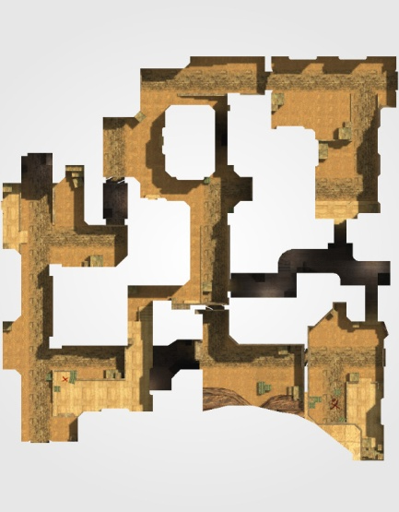
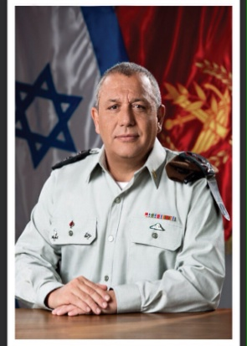
Block Diagram: Overview
Data creation
Collection and analysis
Decision making
Algorithm on the AWS cloud
GPS and MEMS data from each
HMI

Slide 4
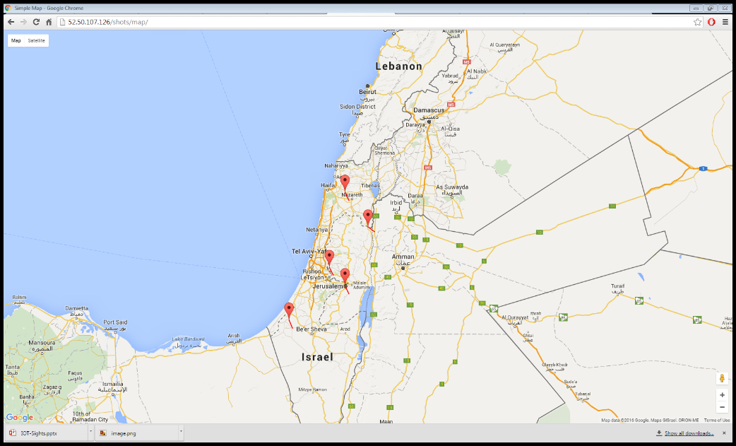
The cloud
Site is located at http://52.50.107.126/ using AWS cloud.
Code is located at https://github.com/sudo-Whateverman/IOTsights

Slide 5
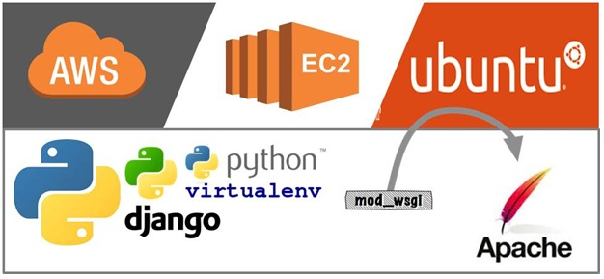
The cloud architecture
Server provider
AWS cloud
Server OS
Ubuntu
HTTP server
Apache
Web application
Written in python and js using Django and google maps api

Slide 6
Implementation rational
FOSS – free open source software
Scalable solution – the same image can be implemented many times behind an elastic load balancer
Easy to develop – python is just easy

Slide 7
Block Diagram: Embedded Device
CC3200 MCU
Internet access: Wi-Fi
MEMS: orientation in space
GPS: location in space
Fired shot detection
SD storage
Barometer: relative altitude

Slide 8
Embedded software: key components
Shot fired detection
Read & process sensor data: GPS, accelerometer, magnetometer and barometer
Calculate orientation angles (roll, pitch, heading)
Unique hardware ID
Wi-Fi and connection to server
SD card for record keeping
Hibernation & wakeup (power saving)

Slide 9
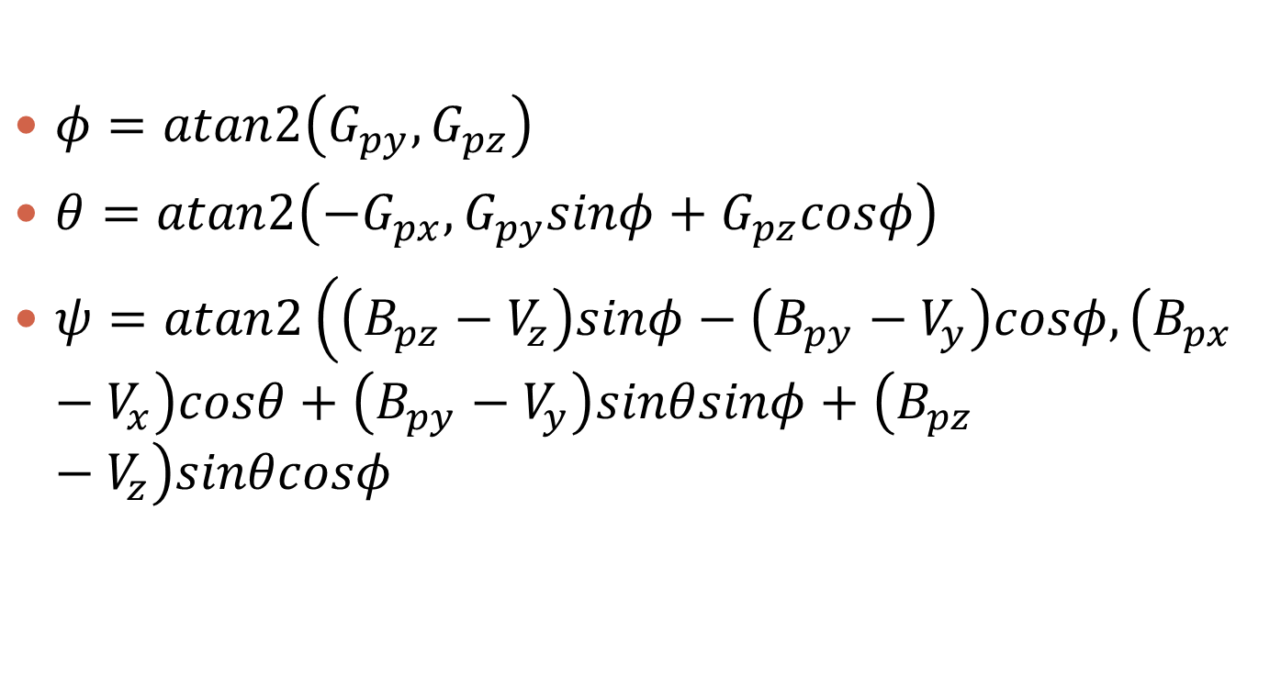
Orientation mathematics
$φ=atan2\left(G_{py}, G_{pz}\right)$
$θ=atan2\left(−G_{px}, G_{py}sinφ+G_{pz}cosφ\right)$
$ψ=atan2\left(\left(B_{pz}−V_{z}\right)sinφ−\left(B_{py}−V_{y}\right)cosφ,\left(B_{px}−V_{x}\right)cosθ+\left(B_{py}−V_{y}\right)sinθsinφ+\left(B_{pz}−V_{z}\right)sinθcosφ\right)$

Slide 10
Embedded software: what remains
Read & process GPS data *in progress*
Read & process barometer data *waiting for parts*
Unique hardware ID *waiting for parts*
Shot fired detection *in progress*
Hibernation/wakeup/power *up next*
Gyroscope sensor fusion *evaluating*

Slide 11
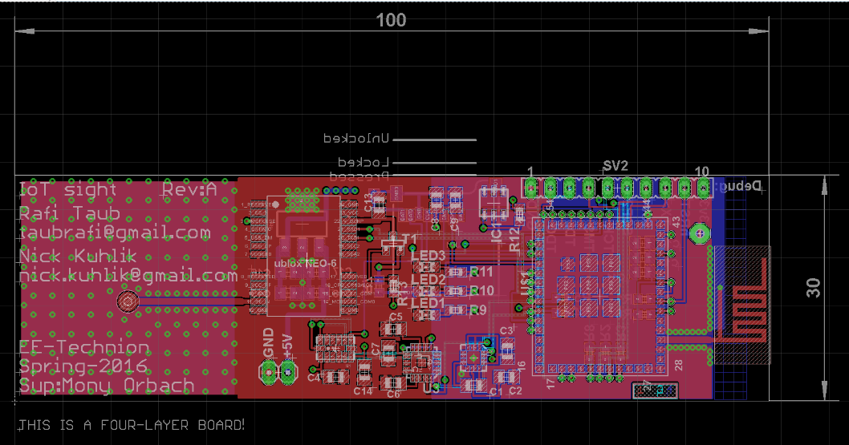
PCB design

Slide 12
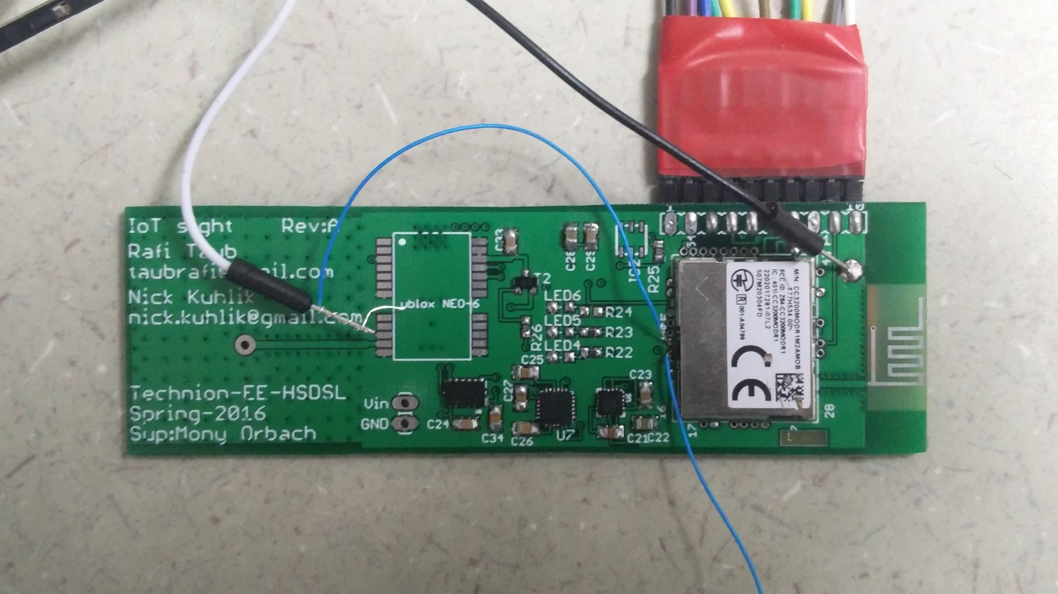
Current PCB

Slide 13
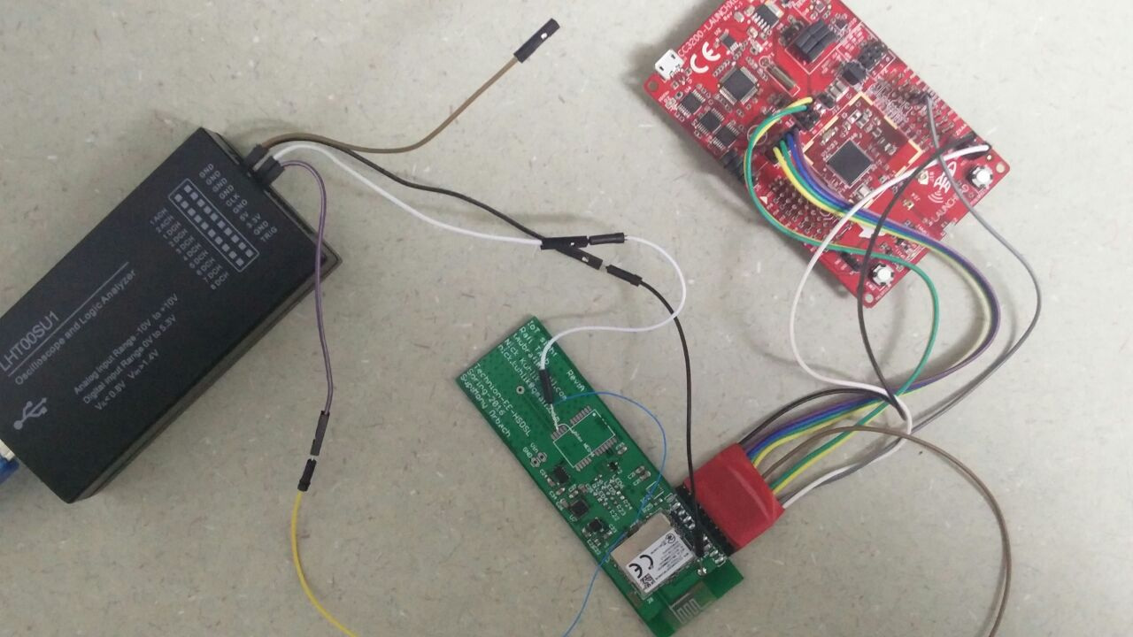
Debugging

Slide 14
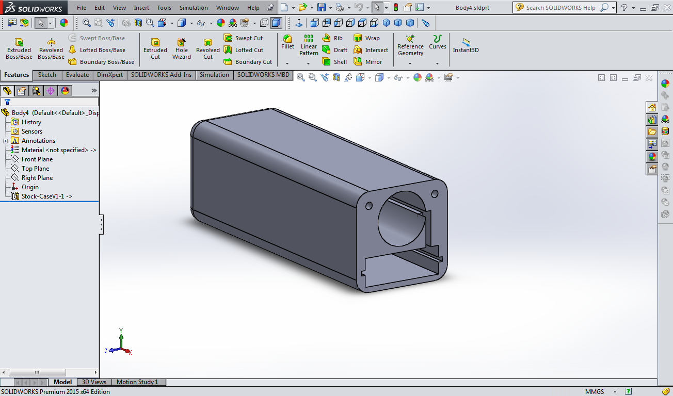
Preliminary enclosure design

Slide 15
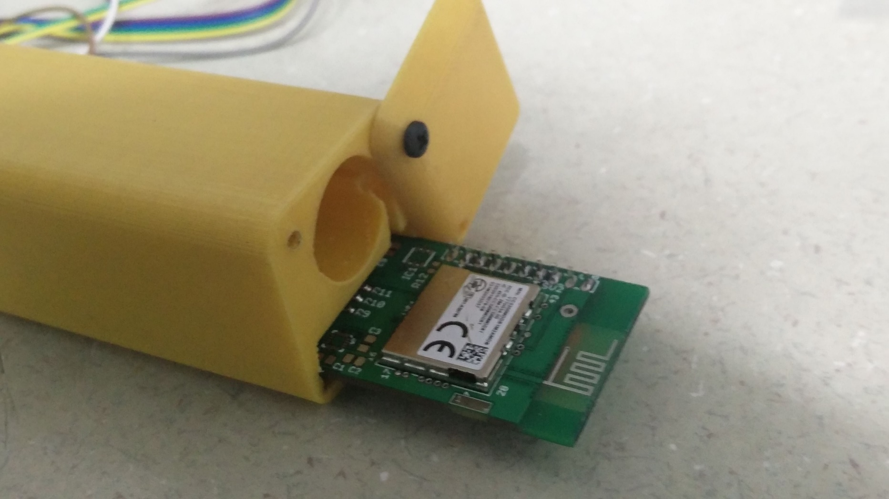
Preliminary enclosure

Slide 16
Power consumption
Intended battery: 2200mAh 3.7v lithium, size 18650
Power consumption:
GPS: active 22mA, idle:22μA
Accelerometer: active 30μA, idle 0.1μA
Magnetometer: active 100μA, idle 2μA
Microcontroller: active ~20mA, transmitting 200mA, low power mode 0.9mA, hibernation 7 μA

Slide 17
Battery life
Minimalist: (not the best)
No GPS until needed, requires 30 seconds to lock (cold start)
Avg. current ~1mA, battery life of 96 days.
Theoretical battery life: (best case)
Never has to broadcast message
GPS active for 5 one second intervals every minute (hot start)
Accelerometer always active (independently detects shot fired)
Avg. current: ~4.3mA, battery life of 21 days!
Worst case:
Shots fired one after the next (without better algorithm)
Avg. current ~54mA, battery life of 40hrs.

Slide 18
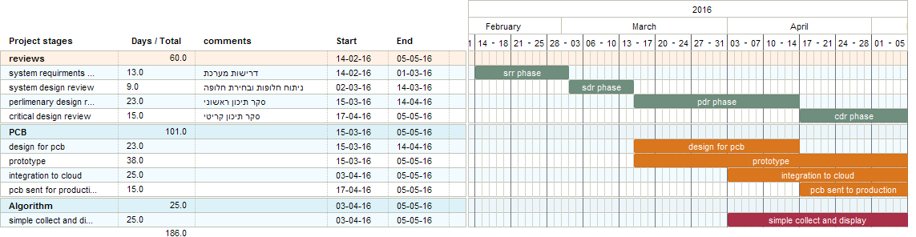
Project Gantt – until mid semester
In the SRR phase we will collect the requirements for the IOT sights, deciding the crucial parts and the “nice to have” ones.
In the SDR phase we will propose different solutions that satisfy the requirements for the project and choose the best solution based on the weights given to each requirement
In the PDR phase we will create the designs that will be used for manufacturing after the CDR and base our model from lessons learned from making a first iteration of breadboard prototype
In the CDR phase we connect the singular system prototype to the cloud to deliver the full functionality.
The conclusion of all of those stages will bring us to the midterm presentation .

Slide 19
TRR readiness
According to the Gantt:
The PCB is delivered but some parts still arrive.
Basic mechanics are complete, mounting on picatiny rail to be added.
The embedded software is almost done.
The cloud is stable and working, but lack css and looks bad. We need to see what algorithmics should be implemented there.

Slide 20
What’s next?
Finish assembling PCB (when parts arrive)
Complete minor additions to embedded software
Implement power saving and hibernation to lengthen battery life.
Improve web interface (CSS)
Field testing (firing range?) - set goals for testing and condition for success.
Add documentation and sign off.

